Slide 1

A Brief History of AI
Richard S. Stansbury
CS 455/595a: Artificial Intelligence

Slide 2
Outline
Learning Outcomes
AI History
Summary
Questions
References

Slide 3
Learning Outcomes
M0-L3: Discuss key milestones of AI history.

Slide 4
Birth of ARTIFICIAL INTELLIGENCE (1943 – 1956)

Slide 5
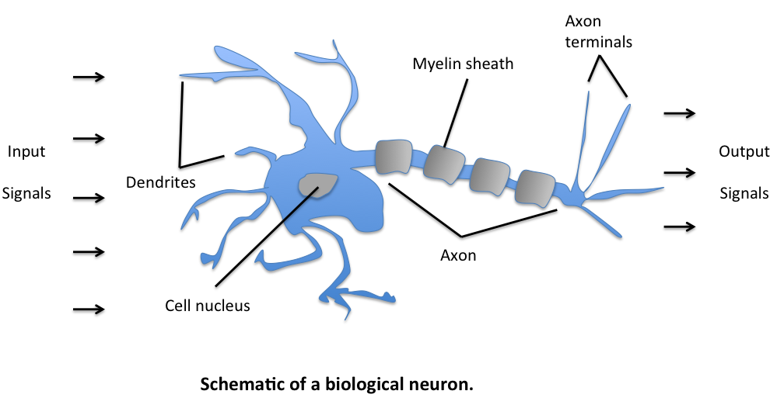
Birth of Artificial Intelligence
McCulloch and Pitts, 1943
Model of neurons of the brain
Binary logic for state of neuron
Proposed learning could be modeled given a network structure
Paper: "A Logical Calculus of the Ideas Immanent in Nervous Activity"
Set cornerstone for Artificial Neural Networks (ANN)
John von Neumann
ENAC and EDVAC
Stored program machines
Funded Marvin Minksy and Dean Edmonds construction of first ANN machine, in 1951
Notes:
http://www.cse.chalmers.se/~coquand/AUTOMATA/mcp.pdf
Image source: https://sebastianraschka.com/Articles/2015_singlelayer_neurons.html

Slide 6
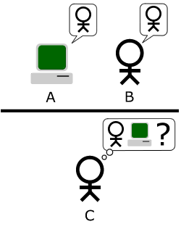
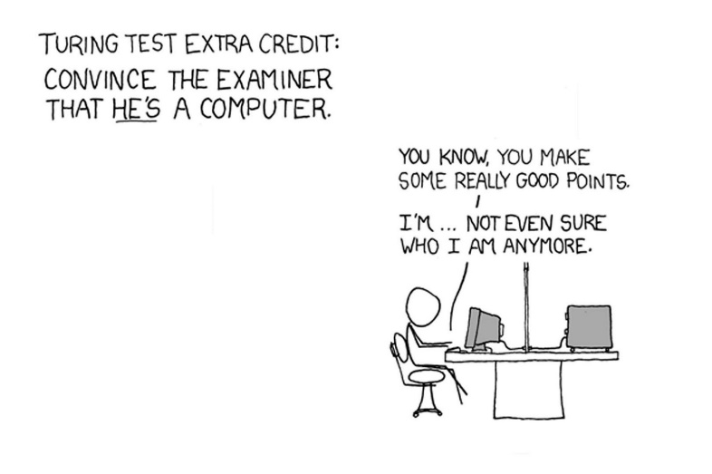
Birth of Artificial Intelligence
Alan Turing, 1950
“Computing Machinery and Intelligence”
Defined turning’s famous “Imitation Game”
Claude Shannon, 1950
Chess playing machine using search techniques
Typical chess game: 10¹²⁰ possible moves
3 x 10¹⁰⁶ years if examining one move per microsecond
This demonstrated a need of heuristics to guide search over large search spaces
McCarthy, Shannon, and Minsky,1956
Workshop at Dartmouth College to bringing together others researching machine intelligence
Workshop gave birth to Artificial Intelligence as a research discipline
Notes:
https://www.csee.umbc.edu/courses/471/papers/turing.pdf
https://www.pi.infn.it/~carosi/chess/shannon.txt
https://vision.unipv.it/IA1/aa2009-2010/ProgrammingaComputerforPlayingChess.pdf
Top Image source:
Bottom image source: https://becominghuman.ai/is-the-turing-test-a-valid-test-of-artificial-intelligence-6695b6e4304

Slide 7
Rise of Artificial Intelligence (1956 to Late 1960s)

Slide 8
Rise of Artificial Intelligence
Great enthusiasm with limited success
McCarthy, 1958
Defined LISP, the AI language for many years
Advice Taker – plan to drive to the airport
Simple axioms
First, knowledge-based system
Bobrow, 1964
“Natural Language Input for a Computer Problem Solving System”
Kicked off natural language processing using AI techniques

Slide 9
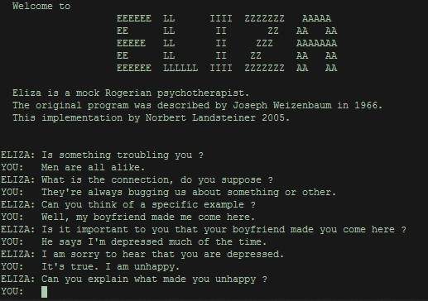
Rise of Artificial Intelligence
Rosenblatt, 1962
Perceptron convergence theorem
Neural networks could learn the connection strengths and thus be trained for a particular problem
Newell and Simon, 1961/1972
General Problem Solver
Separate problem solving technique from the data
Used Means-Ends Analysis
States define problem
Analysis to determine distance from goal state
Operators to transition between states
Weizenbaum, 1964
Developed ELIZA
Followed a script to emulate communication with a psychoanalyst.
Early example of chat bot

Slide 10
Rise of Artificial Intelligence
Period really captured the research into general methods
Such as general purpose search
Referred to as “weak methods” as weak application of information resulted in weak performance
Lotfi Zadeh, 1965 (Berkley)
Introduced Fuzzy Sets
Unrealized gem of the era
Mostly overlooked. “Fuzzy” kept it from being taken as seriously.
Projects die off as AI seemed unable to solve real-world problems

Slide 11
Disillusionment (aka AI Winters) (1960s and 1970s)

Slide 12
The Disillusionment
Realization of goal that computers would exceed humans by 2000 was far too optimistic
General methods resulted in search strategies, which only worked on smaller scale “toy” problems
Could not scale up to larger problems
Weakly applied problem knowledge to the solution process
NP-Completeness 1970s
Problems solvable in polynomial time were considered tractable
Hard problems were intractable
NP-Complete are the hardest class of problems (intractable)
Remain hard despite additional processor and larger memory

Slide 13
Expert Systems (Early 1970s to Mid-1980s)

Slide 14
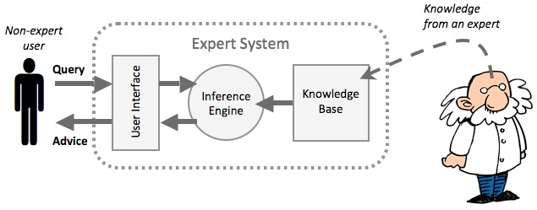
Expert Systems
Restriction of intelligent system problem domains brought about change
Large reasoning steps of narrow domains of expertise.
DENDRAL, Buchanan et al., 1969
Mars probe soil analysis
Testing every combination would be time consuming
Scientists could solve problem using experience and expertise, “rules-of-thumb”
Experience and expertise were encoded to create the first expert system.
General knowledge encoded as highly specific rules.
Notes:
Image source: https://www.igcseict.info/theory/7_2/expert/

Slide 15
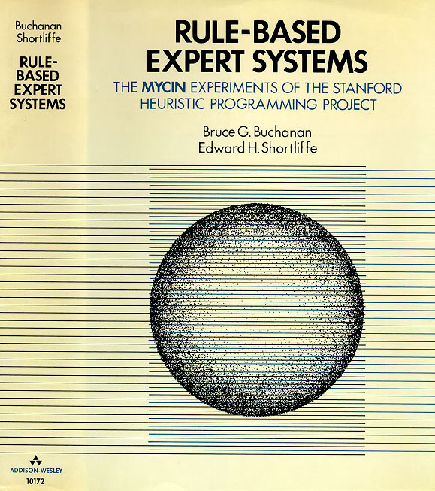
Expert Systems
MYCIN, 1976
Rule-based system for diagnosis of blood diseases
Better than junior doctors
450 if-then rules independent from reasoning mechanism
Certainty factors
PROSPECTOR, 1979
Geological knowledge for mineral prospecting
Bayesian rules
Special languages used: LISP, PROLOG, OPS, etc.
Notes:
Image source: http://people.dbmi.columbia.edu/~ehs7001/Buchanan-Shortliffe-1984/MYCIN%20Book.htm

Slide 16
Expert Systems
Issues with expert systems:
Not robust since defined with highly narrow view of expertise
Limited explanation of solutions
Difficult to verify and validate
Little to no ability to learn

Slide 17
Neural networks – Round 2 (1965 to 1980s, Mostly 1980s)

Slide 18
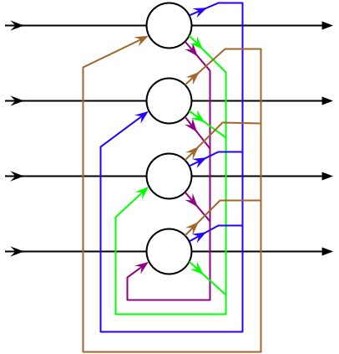
Return of the Neural Network
By late 1960s, most ideas founded, but not until the surge of personal computers to ANN take off.
Grossberg, 1980
Adaptive Resonance Theory
Hopfield, 1982
Hopfield networks – ANN with feedback
Kohonen, 1982 – self-organized maps
Hopfield Network
Notes:
Image source: https://en.wikipedia.org/wiki/Hopfield_network

Slide 19
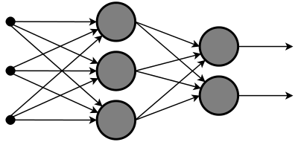
Return of the Neural Network (cont.)
Back-propagation learning algorithms, 1986
Originally, Bryson and Ho, 1969
Reinvented by Rumelhart and McClelland, 1986
Most popular technique for training neural network
Lowe, 1988
Layered feed-forward network
Inputs
Outputs
Notes:
https://en.wikibooks.org/wiki/Artificial_Neural_Networks/Feed-Forward_Networks

Slide 20
Evolutionary Computation (1970s onward)

Slide 21
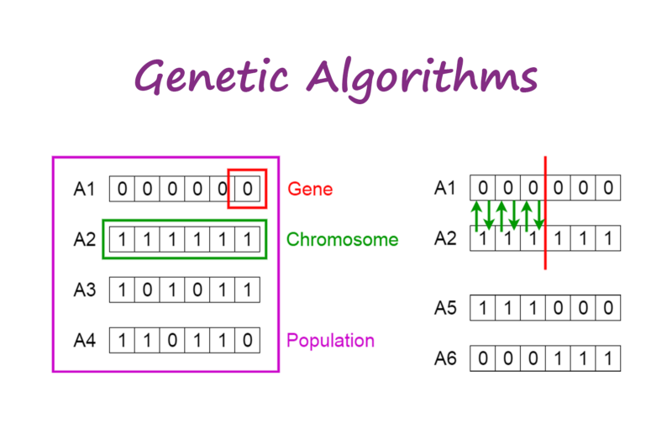
Evolutionary Computation
Natural intelligence derived from evolution.
Complete for survival
Evolutionary computation: genetic algorithms, evolutionary strategies, genetic programming
Holland, 1975
Introduced genetic algorithms. Artificial chromosomes
Schema Theory
Koza, 1990s
Genetic programming – rather than solve a problem it created programs
Notes:
https://towardsdatascience.com/introduction-to-genetic-algorithms-including-example-code-e396e98d8bf3

Slide 22
Fuzzy Systems (1980s onward)

Slide 23
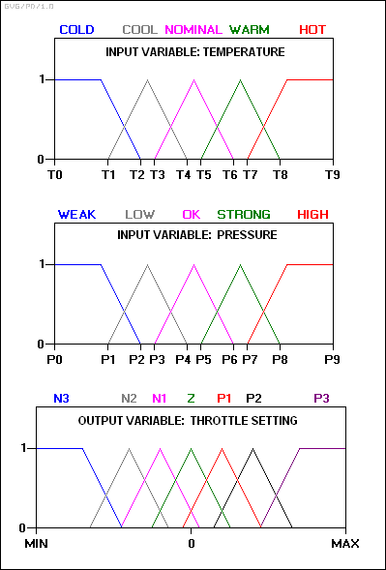
Fuzzy Systems
Linguistic variables – rather than using continuous values or discrete values over a range, linguistic values cover some range.
e.g.low, medium, high for 0 to 33, 34 to 66, 67 to 100.
Fuzzy logic – uses linguistic descriptions of vague or uncertain data.
Zadeh, 1965
Introduced fuzzy set theory.
Shunned in the west, but embraced by Japan
Dishwashers, washing machines, etc. – 1980s
Notes:
https://pdfs.semanticscholar.org/f26c/be40db22c9b99fe95d368c3aff94beaef488.pdf

Slide 24
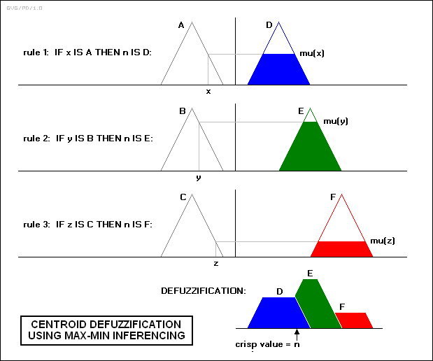
Fuzzy Systems
Benefits from fuzzy systems:
Improved computation
Faster to solve and fewer rules
Improved cognitive modeling
Support for multiple (possibly conflicting) experts

Slide 25
Modern Artificial Intelligence (1990s onward)

Slide 26
Modern AI
Agents
Minksy’s Society of the Mind
Web-based agents mine data from the internet for a variety of purposes:
search engines, national security, etc.
Significant improvements in many areas of AI related sub domains, 1990s
Case-based reasoning, natural language processing, image processing, multi-agent systems, data mining, etc.
Automated loan underwriting and fraud detection used in banking
Deep Blue beats Gary Kasparov, , 1997
Brute force
Utilized alpha-beta pruning in parallel using VLSI chips
Despite the name, it does not utilize deep learning
DARPA Grand and Urban Challenges, 2004, 2005, 2007
Rise in demand of automation for ground vehicles

Slide 27
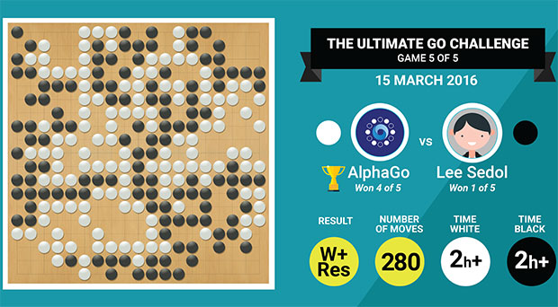
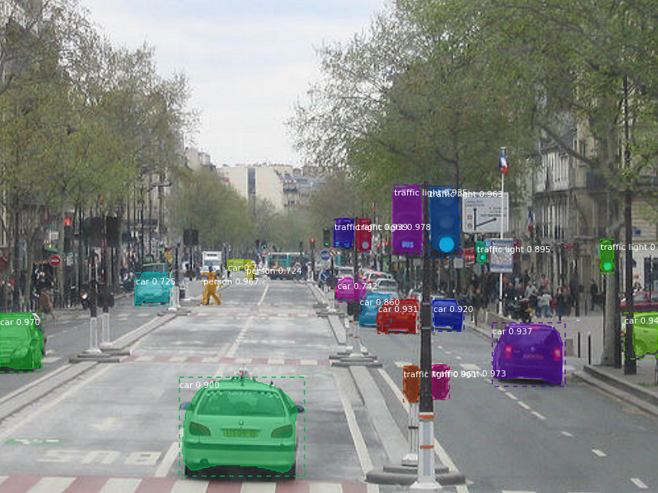
Modern AI
Deep Neural Networks
Neural network applications were found resulting in a steady increase in the use of ANN. Combined with improved computational power has seen a large increase in deep learning research
Long Short-Term (LSTM) - recurrent neural network 1997 for speech and handwriting recognition
Gregory Hinton, 2006, introduced use of ANN to generate sensory data from trained input
Gives rise to the use of ANN to handle feature extraction
Raina, Madhavan and Ng, “Large-scale Deep Unsupervised Learning using Graphics Processors,” 2009
Showed that graphics processing units (GPUs) provided superior computational abilities for deep learning architectures than traditional GPUs.
The utilization of GPU technology has been revolutionary in facilitating the adoption of deep learning.
ImageNet Large-Scale Visual Recognition Competition starts, 2010
Image classification
Major benchmark for convolutional neural network architectures
2016, Google AlphaGo defeats Go champion
Notes:
Top image source: https://spectrum.ieee.org/tech-talk/computing/networks/alphago-wins-match-against-top-go-player
Bottom image source:

Slide 28
Modern AI
Other trends:
Rise of Internet technologies over the past several decades has provided
Great access to data
More data available
Big data problems
Industry drive for machine learning / data science related research supporting business intelligence, customer satisfaction marketing , analytics, finance, etc.
Machine learning and Artificial Intelligence tool/library availability
Increase in free-open source solutions
Rising developer base, data availability, and benchmarks has resulted in rapid advancements in software tools and libraries.

Slide 29
Wrap-up

Slide 30
Summary
In general, we can define AI and ML as follows:
AI is the concept of developing software that is capable of performing tasks that would typically require some form of intelligence.
Machine learning is a sub-domain of AI focused on enabling learning within the system through supervised and unsupervised means.
Community consensus on definitions still evolving
Broad domains
AI/ML include numerous sub-domains, which can be divided further.
Advances such as deep learning show potential for moving AI from weak toward strong.

Slide 31
Questions
Notes:
Image Source: https://svgsilh.com/image/1751308.html

Slide 32
References
Callaghan Innovation. “AI Demystified.” Online at: https://www.callaghaninnovation.govt.nz/blog/ai-demystified, last accessed 01/03/2019.
Intel AI Academy, “Infographic: Get Started with AI Development Today,” Online at: https://software.intel.com/en-us/articles/infographic-get-started-with-ai-development-today, last accessed 01/03/2019.
Liise Ruuse, “Artificial Intelligence: Everything You Want to Know,” Scoro, Online at: https://www.scoro.com/blog/artificial-intelligence-everything-you-want-to-know/, last accessed 01/03/2019.
SKLearn.org, “Choosing the Right Estimator”, Online at: https://scikit-learn.org/stable/tutorial/machine_learning_map/index.html, last accessed 01/03/2019.
The Computing Center, “Machine Learning & Deep Learning 101” Online at: http://www.compcenter.com/client/index.cfm/2018/7/30/Machine-Learning--Deep-Learning-101, last accessed 01/03/2019.

